Slide 1

Knots and Quandles
Joey Fischer
5/9/2024

Slide 2

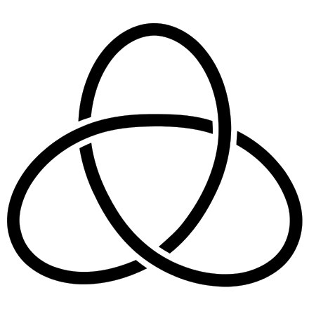
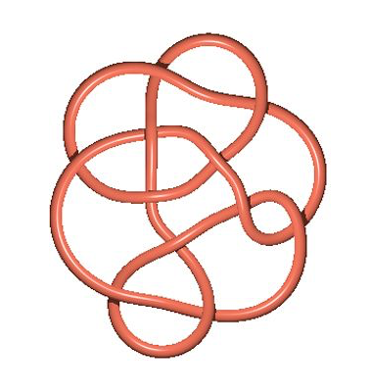
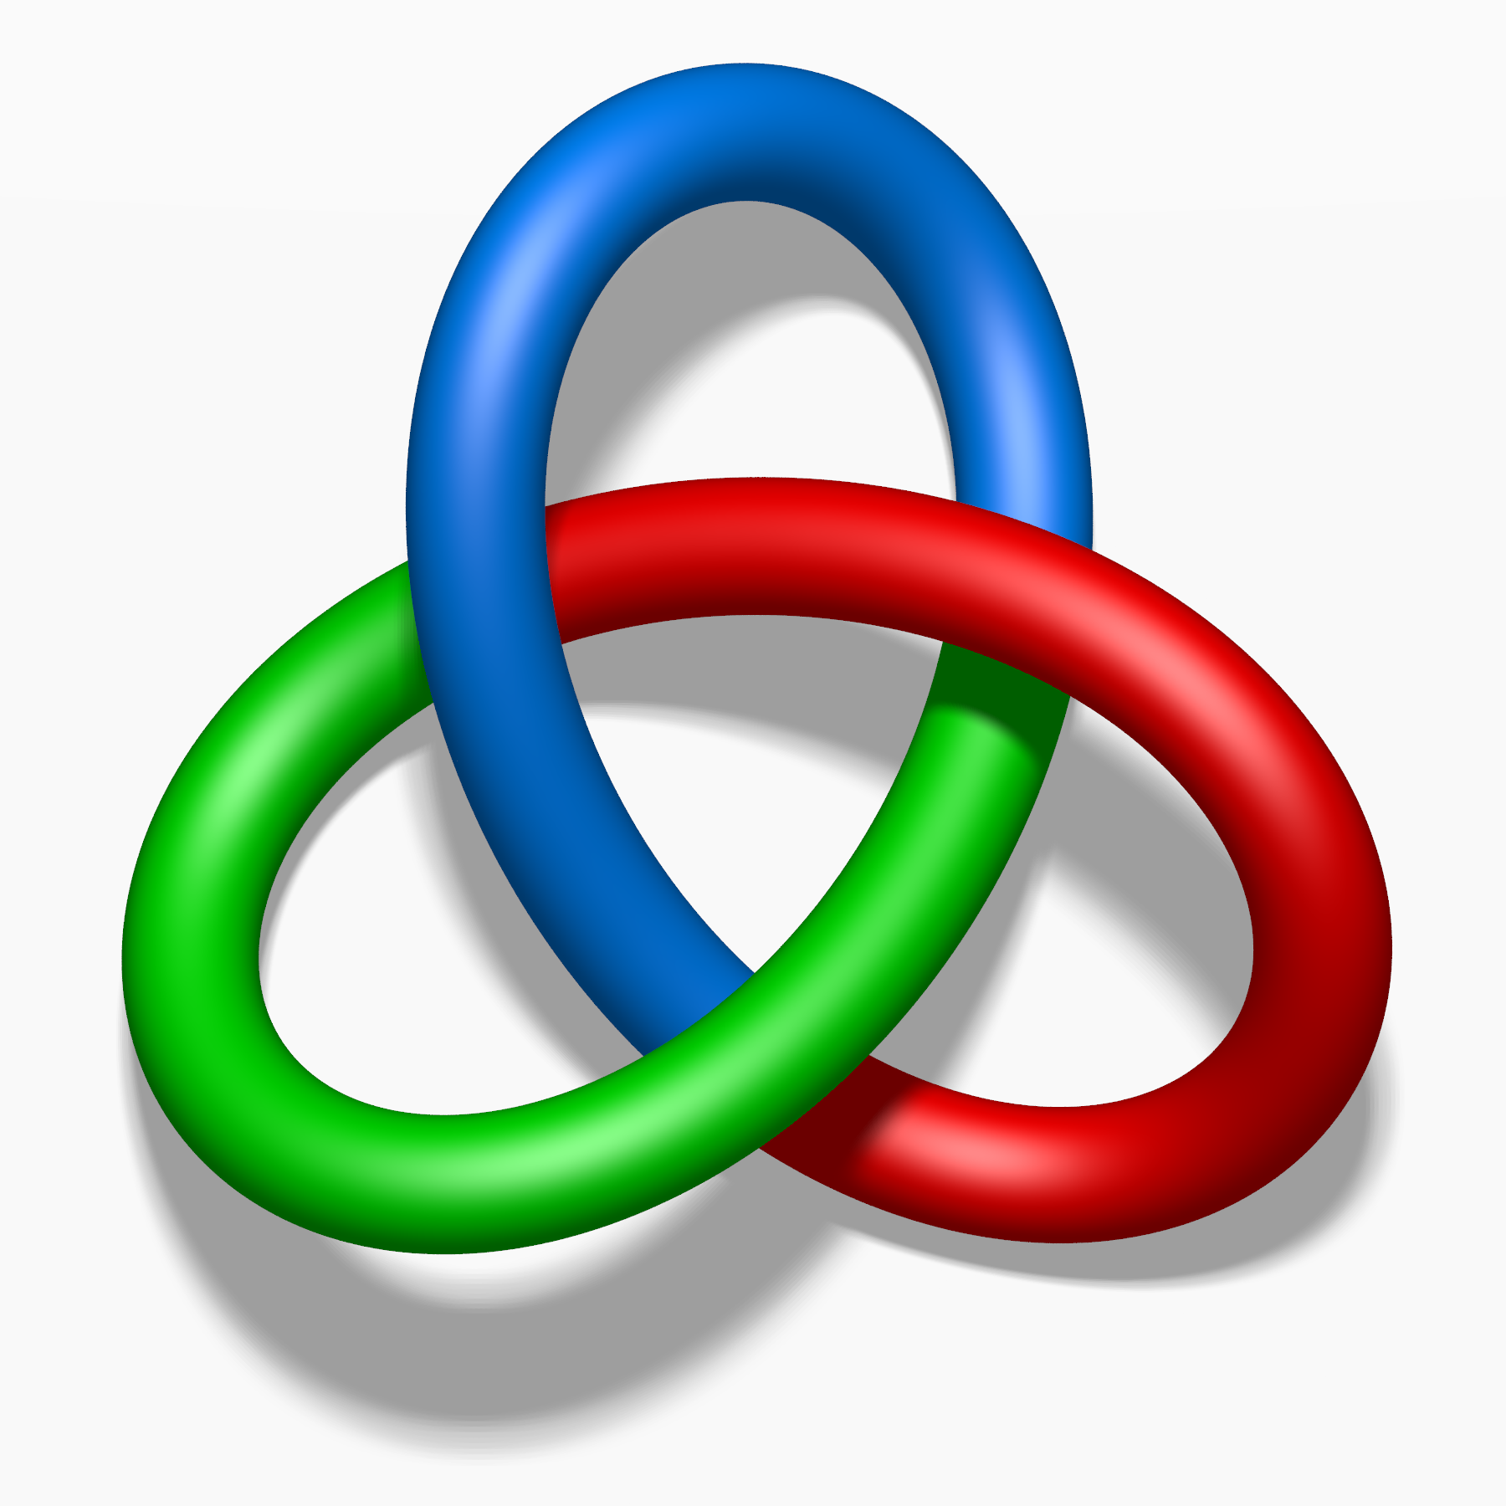
Knots
Invariants
a simple closed curve that does not intersect itself and has no loose ends
Live in 3-dimensional space, but we use 2-dimensional diagrams to show them
Knots are very hard to tell the same, especially when they become more complex, so invariants are used to tell two knots apart
Tricoloring
Tricoloring is an invariant where all colors at a given crossing have to be all the same or all different
Weak invariant since a knot is
either tricolorable or not

Slide 3
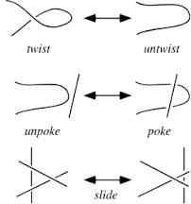
Reidemeister Moves
1
Within knots diagrams there are three basic moves we can make to alter the diagram without changing the knot
We can make or remove a twist
Cross a strand over another
Slide a strand under a crossing of two other strands
2
3

Slide 4
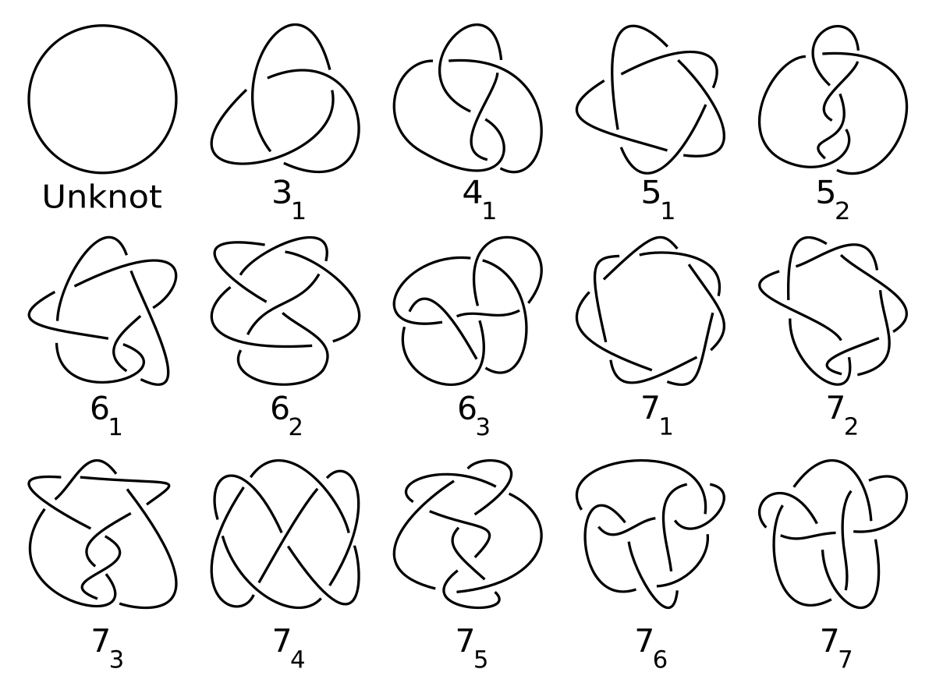
Prime Knots
Prime knots are knots that cannot be decomposed into two nontrivial knots
The unknot is the trivial knot
I wanted to prove the prime knots as unique from each other
I decided to code an algebraic invariant for all of these knots

Slide 5
Quandle Relation to Knots
Quandles
Each of the quandles axioms relates to a specific Reidemeister move, giving us an algebraic way to operate on knots
The first Reidemeister moves relates to idempotency
The second relates to crossing a strand over another
The third relates to sliding a crossing under two other strands
Quandles are sets X with the binary operation ▹ :
Idempotency- elements don’t affect themselves
for all x ∈ X , x▹x=x
Right-Inverse
for all x,z ∈ X , there exists a unique y such that x▹y=z
Self-distributivity
for all x y, z ∈ X,: (x▹y)▹z = (x▹z)▹(y▹z)
1
2
3

Slide 6
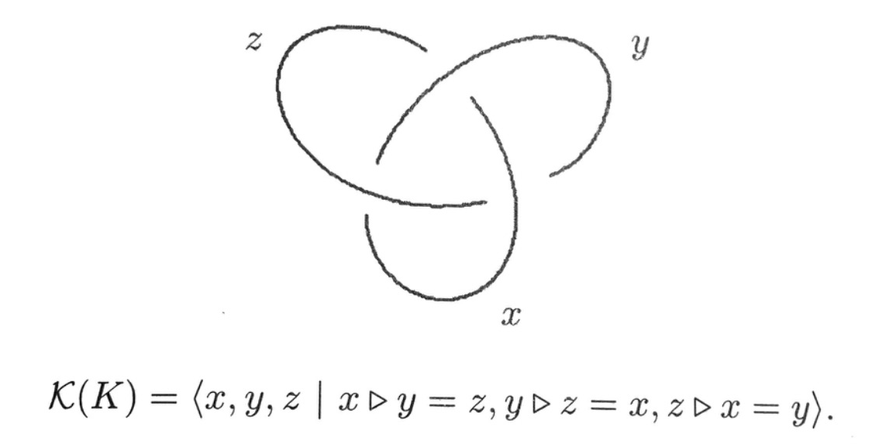
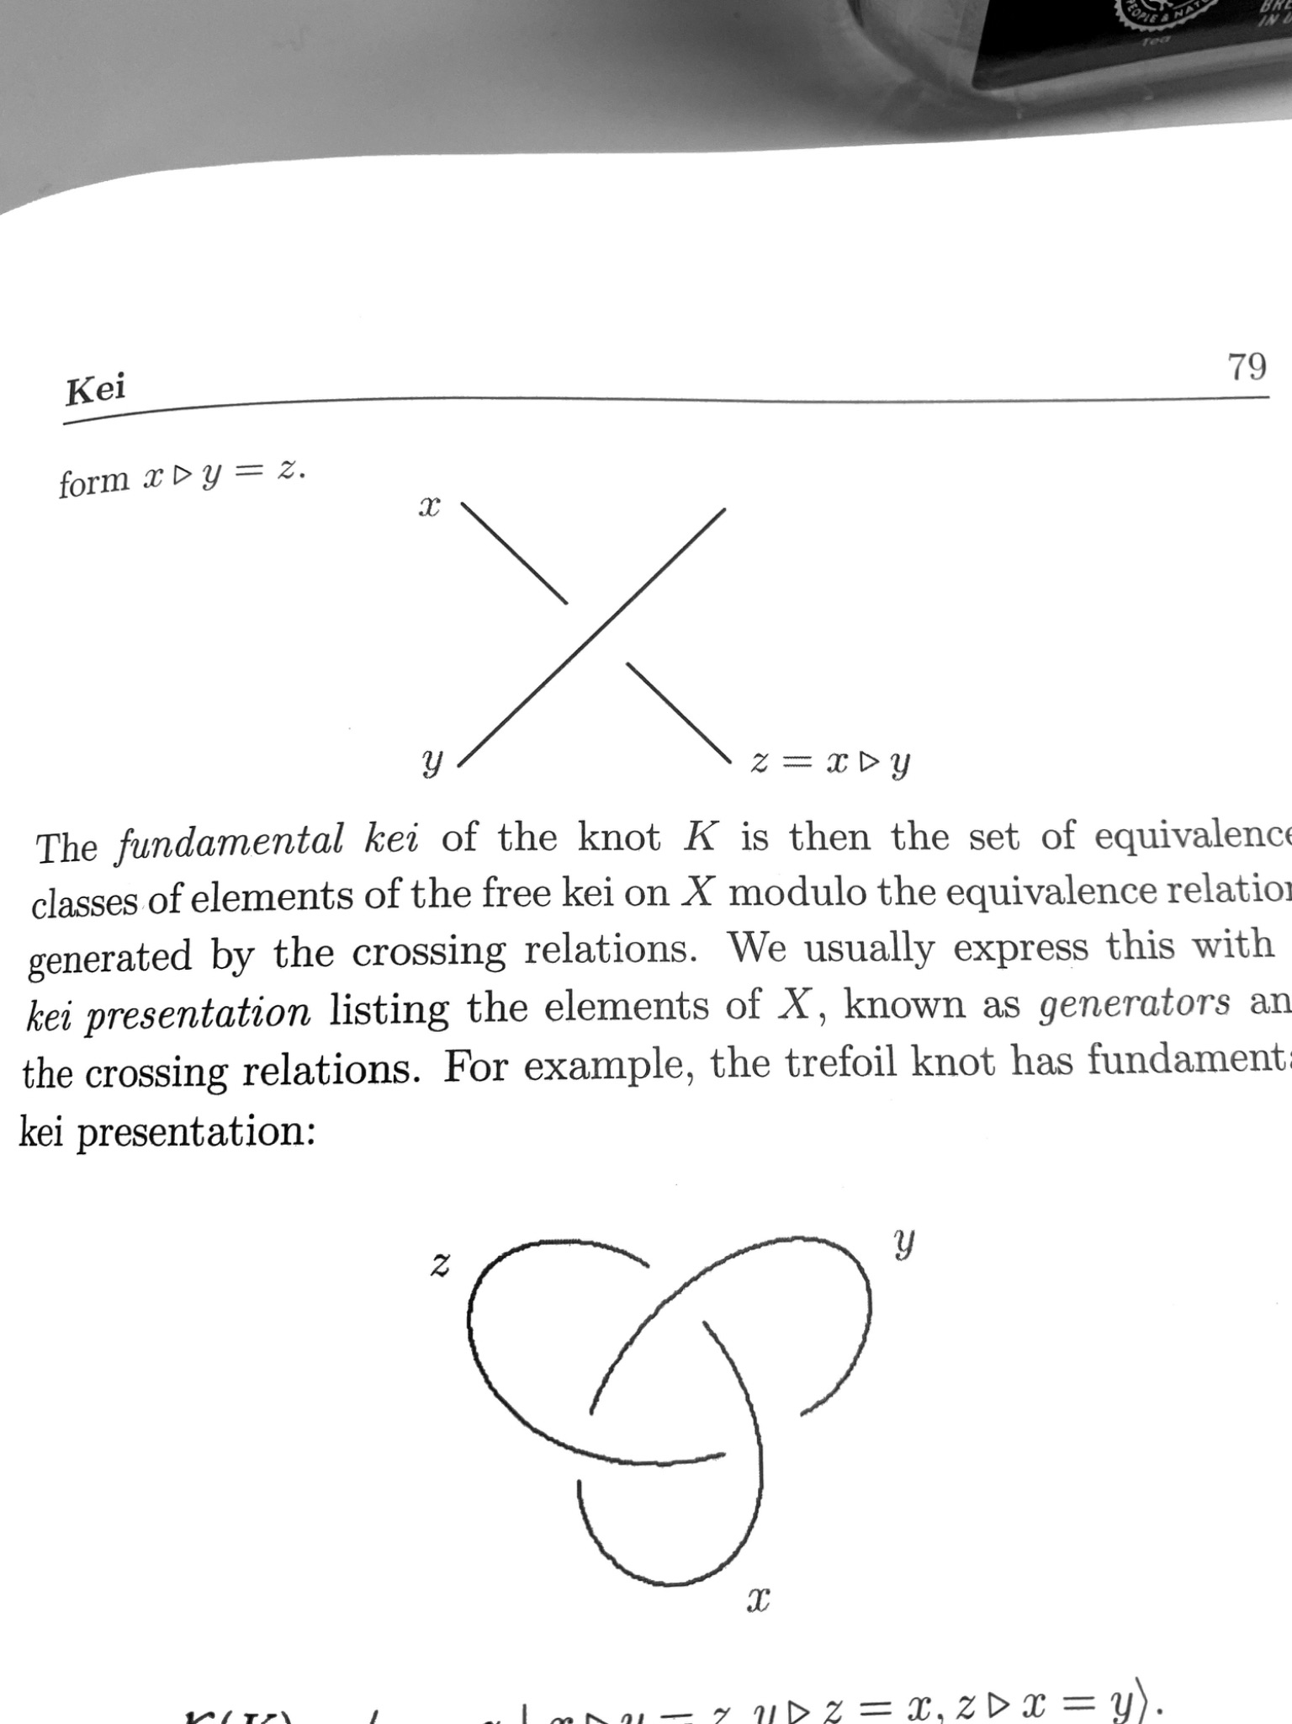
Free Quandle
Here we define x crossing under y as x▹y=z
One generator per arc, one relation per crossing
𝒬
Using this definition, we get what is called a free quandle from the knot relations
If two knots have the same free quandle, they are the same

Slide 7
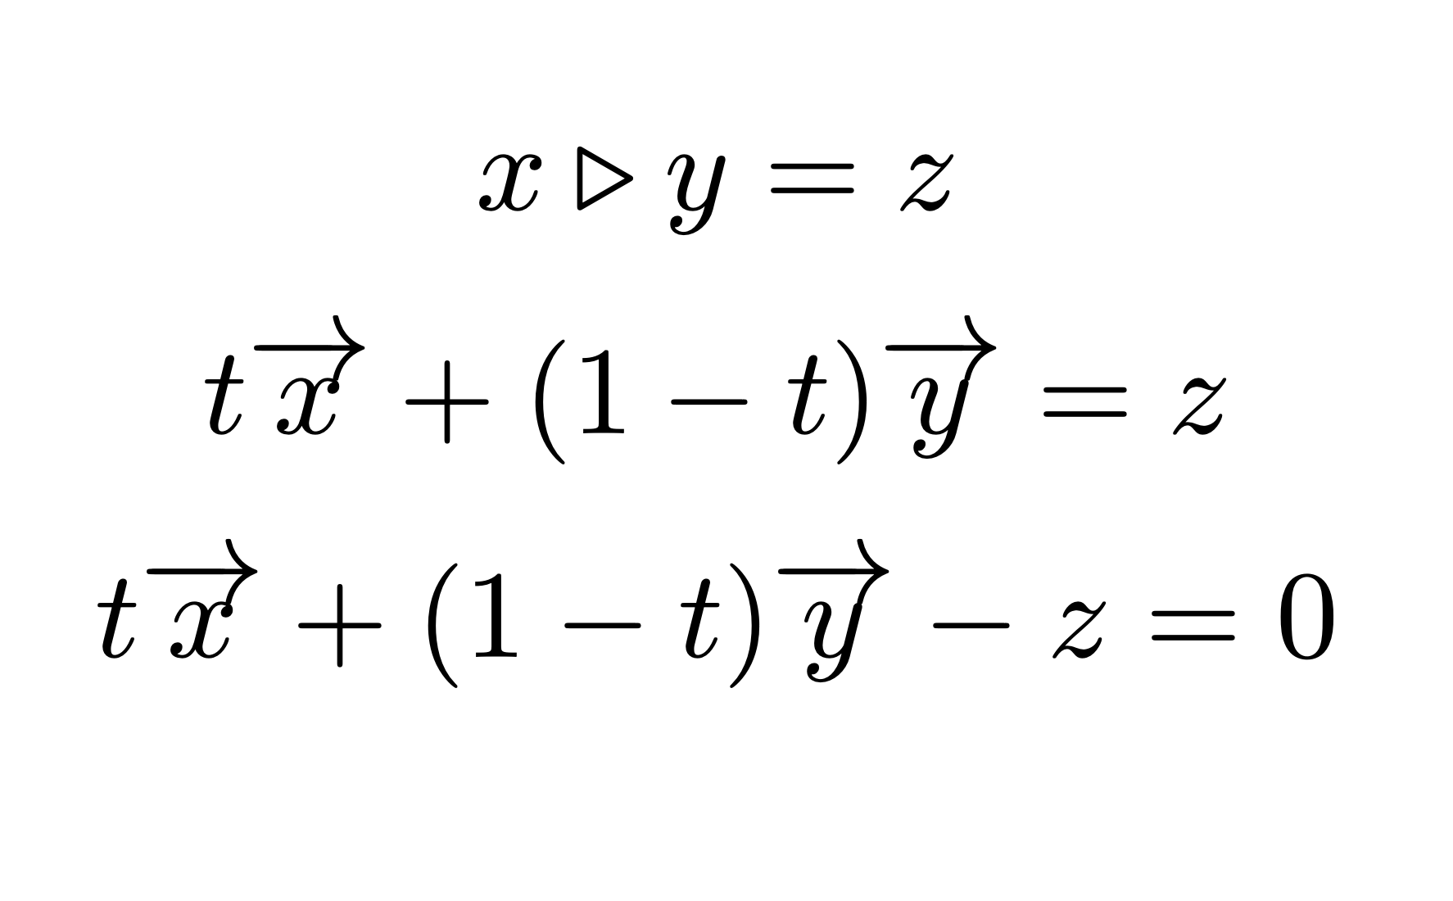
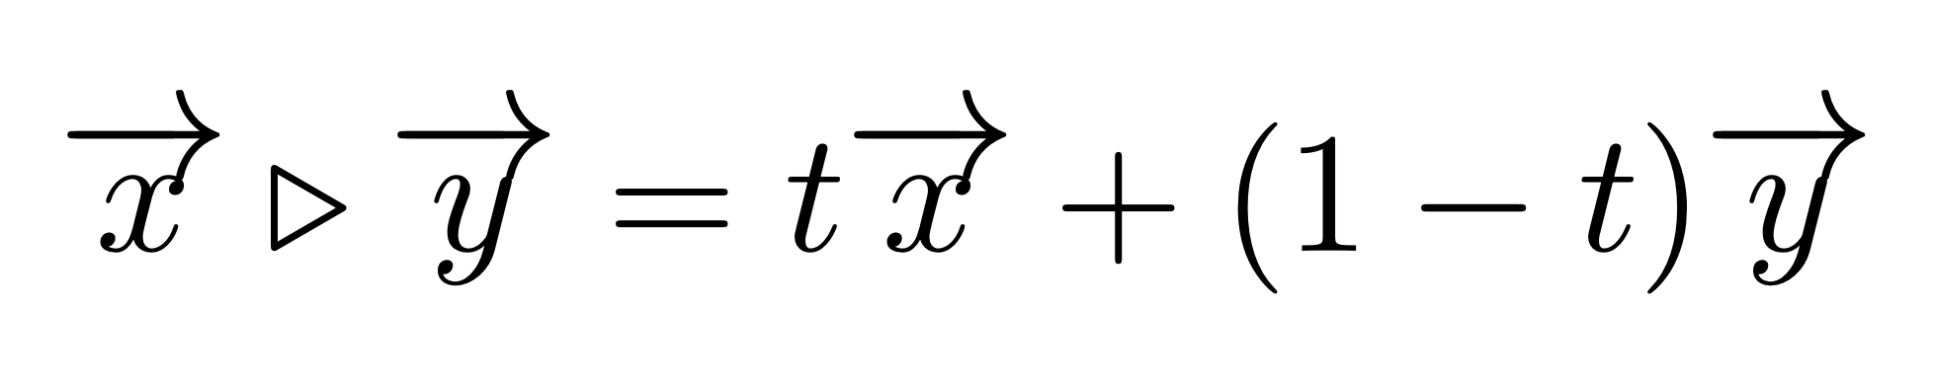
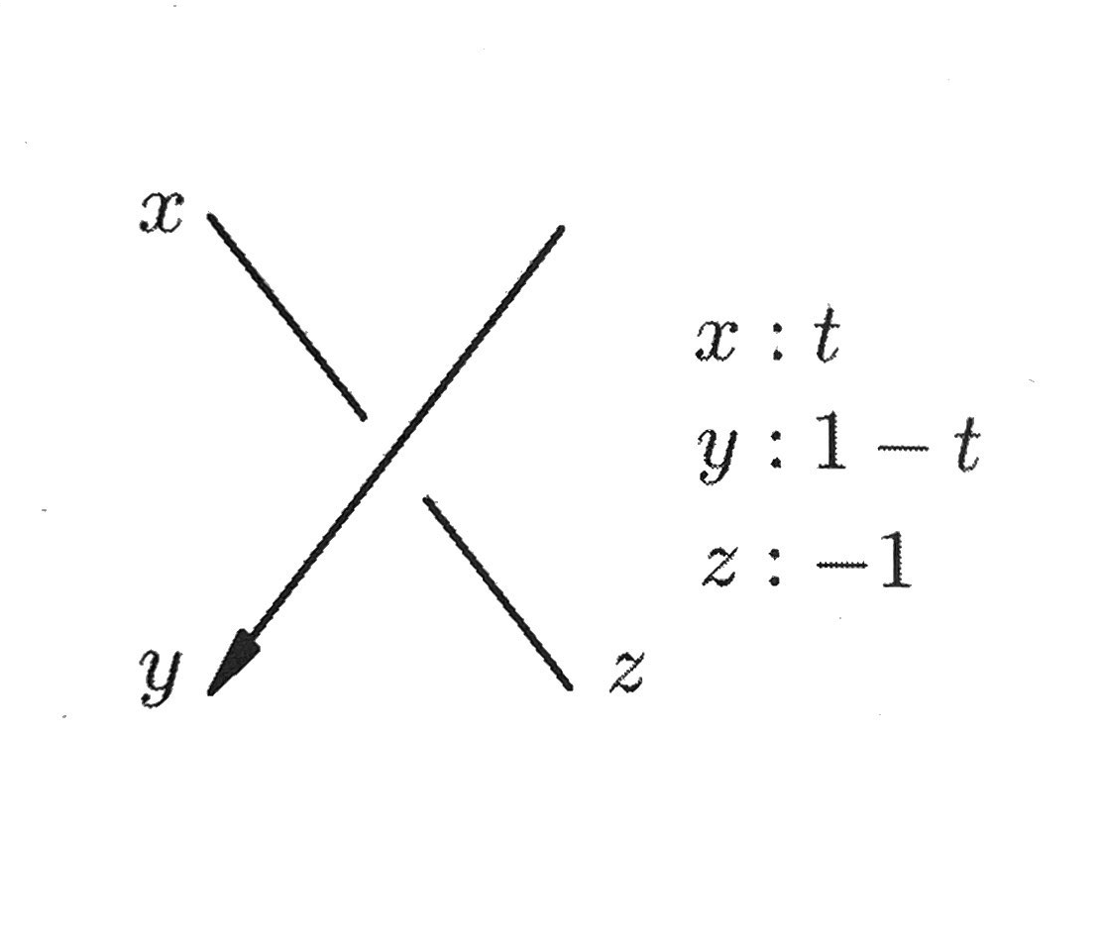
Alexander Quandle
The operation for the alexander quandle is defined as
One specific type of quandle is the Alexander Quandle which is defined on modules over ℤ[t,t⁻¹]
The operation for the alexander quandle is defined as
One specific type of quandle is the Alexander Quandle which is defined on modules over ℤ[t,t⁻¹]
After solving for the coefficients, we can create a new rule
Using this rule we can create matrix representations of knots by labeling strands of each crossing to one of the values, 0, t, -1, or 1-t

Slide 8
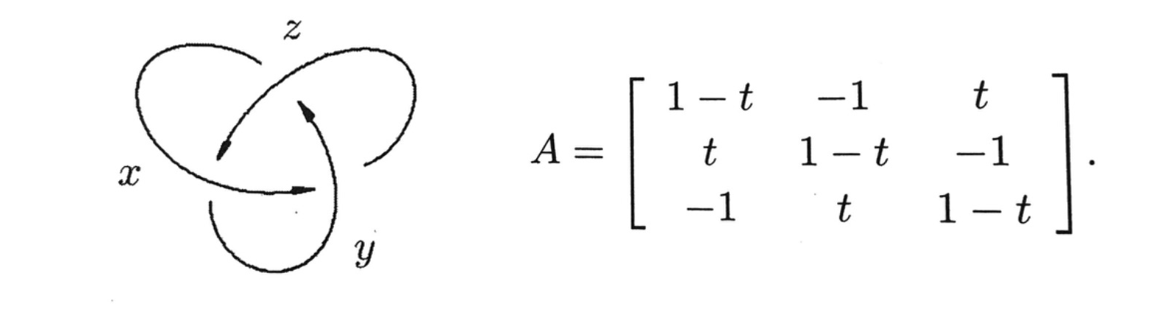
Demonstration - Trefoil
Take the determinant of the first minor, by deleting one row and one column
This polynomial is an invariant and can be used to differentiate knots
Alexander Polynomial: t^2-t+1

Slide 9
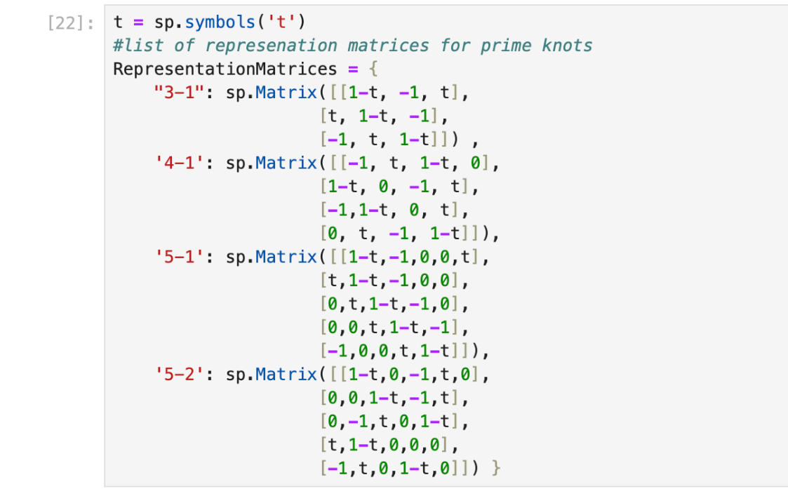
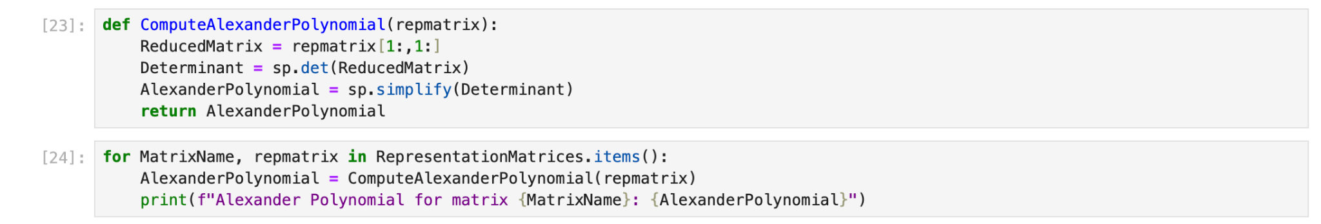
Coding
I input the representation matrices of the prime knots into my code and then just created a formula that removes a row and column from the representation matrix, giving us the alexander polynomial for that knot

Slide 10
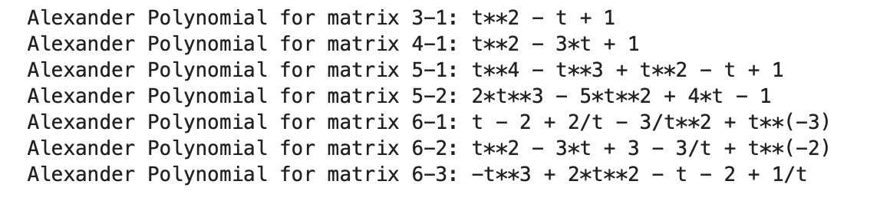
Results
With this code, I have since proved the first 7 prime knots to be unique from each other
Applications of Knots
DNA molecules are acted upon by enzymes in similar ways to the Reidemeister moves
We can use knot theory to understand the topology of DNA molecules

Slide 11
Citations
Adams, C. C. (2004). Knot Book - An Introduction to the Mathematical Theory of Knots. American Mathematical Society.
Elhamdadi, M., & Nelson, S. (2015). Quandles: An introduction to the algebra of knots. American Mathematical Society.
Wikimedia Foundation. (2023, February 18). Prime knot. Wikipedia. https://en.wikipedia.org/wiki/Prime_knot
Wolfram. (n.d.). Reidemeister moves. Wolfram MathWorld. https://mathworld.wolfram.com/ReidemeisterMoves.html

